Slide 1
EPYGENIX THERAPEUTICS Precision medicine for rare forms of genetic epilepsy
July 2020

Slide 2
Safe Harbor
Safe Harbor Statement. This presentation contains forward-looking statements that involve risks and uncertainties, which may cause actual results to differ materially from the statements made. For this purpose, any statements that are contained herein that are not statements of historical fact may be deemed to be forward-looking statements made pursuant to the safe harbor provisions of the Private Securities Litigation Reform Act of 1995. Without limiting the foregoing, the words "believes," "anticipates," "plans," "intends," "will," "should," "expects," "projects," and similar expressions are intended to identify forward-looking statements. You are cautioned that such statements are subject to a multitude of risks and uncertainties that could cause actual results, future circumstances, or events to differ materially from those projected in the forward-looking statements. These risks include, but are not limited to, those associated with the success of research and development programs, the regulatory approval process, competition, securing and maintaining corporate alliances, market acceptance of the Company's products, the availability of government and insurance reimbursements for the Company's products, the strength of intellectual property, financing capability, the potential dilutive effects of any financing, reliance on subcontractors and key personnel. The forward-looking statements are made as of the date hereof, and the Company disclaims any intention and has no obligation or responsibility, except as required by law, to update or revise any forward-looking statements, whether as a result of new information, future events, or otherwise.

Slide 3
Company Overview
Hahn-Jun Lee, M.Sc., Ph.D.
President & CEO
Epygenix Therapeutics, Inc.

Slide 4
Highlights
THE COMPANY
Privately held US-based biotech headquartered in New Jersey
Developing drugs for pediatric genetic epilepsies
Pipeline is based on scientific outcomes from Professor Scott C. Baraban’s lab at UCSF
DE-RISKED ASSET PORTFOLIO BY DRUG REPURPOSING
Three (3) clinical stage assets for Dravet Syndrome (DS) and Lennox Gastaut Syndrome (LGS)
Critical catalyst – EPX-100 top line Phase II data expected in Q4 2020 in Dravet Syndrome
High level of confidence for positive data readout expected in H2 2020
Predictive accuracy of zebrafish screening system is higher than rodent models
Both EPX-200 and -300 identified with zebrafish screening system, already confirmed the clinical efficacy in DS patients
EPX-100 Phase I data confirmed a clean safety profile
OPPORTUNITY
Significantly growing market
More favorable treatment option with better safety and efficacy are continuously needed

Slide 5
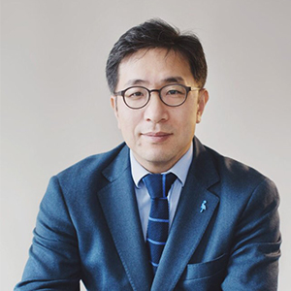
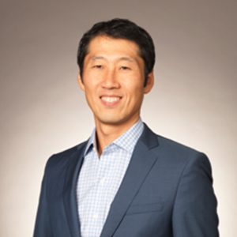
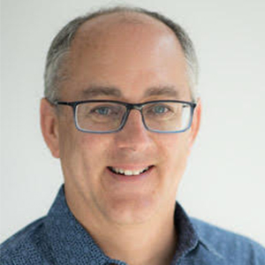
Experienced Team
Hahn-jun lee, MSc, pHD
Alex yang, JD
Scott C. Baraban, Phd
Founder, President & CEO
Founder/CEO, Polaryx Therapeutics, Inc
Founder/CEO, Focus Therapeutics, LLC
Co-founder/CEO, Curyx Bio, Inc.
Assistant Professor of Biotechnology at Columbia University, NYC
Staff Scientist at RIKEN Brain Science Institute, Japan
B.S., Sogang U., Korea
M.S. & Ph.D., U. of Tokyo, Japan
Chairman of Board
CEO at Mstone Partners Hong Kong, Co-founder of Curyx platform
Formerly, Managing Partner at Kim & Chang and Partner at Ernst & Young Hong Kong
Formerly, Morgan Stanley Hong Kong office in Private Equity and In-house Counsel
New York University School of Law with both JD and LLM degrees
Economics at Binghamton Univ
Member of New York State Bar
Co-Founder & SAB Chair
Professor & William K. Bowes Jr. Endowed Chair in Neuroscience Research, UCSF
Adjunct Professor Helen Wills Neuroscience Institute, UC Berkeley
B.S., Johns Hopkins University
Ph.D., University of Virginia
2015 NIH Javits Neuroscience Investigator Award
2016 American Epilepsy Society Research Recognition Award (Basic)
SCIENTIFIC ADVISORY BOARD
Joseph Sullivan, MD I UCSF
Linda Laux, MD I Northwestern University
Jack Parent, MD I University of Michigan
Manisha Patel, PhD I University of Colorado, Denver

Slide 6
Portfolio Profile
Multi-Asset Development Pipeline
Three safe and well-tolerated compounds for Dravet Syndrome
Comprehensive screening process leveraged to identify potentially relevant compounds and preemptively minimize future competing compounds
Innovative Scientific Background
Zebrafish-based proprietary screening developed at Prof. Baraban’s lab at UCSF
Human safety and proof-of-concept already have been established for EPX compounds
Distinct Competitive Advantage
Superior safety profile compared to other treatment options
No potential for EPX-100 off-label use as drug is not commercially available
Robust IP Portfolio
Robust IP protection including multiple patents, as well as, Orphan Drug Designation (ODD) and Rare Pediatric Disease (RPD) Designation
Patents and regulatory incentives provide market exclusivity to 2040 and beyond
Attractive Market Opportunity
~15,000 – 20,000 Dravet Syndrome patients and ~ 30,000 – 50,000 Lennox-Gaustaut Syndrome patients in the U.S
EPX-100 has further potential for indication expansion, with possible use in the treatment of generalized epilepsy and seizures associated with tuberous sclerosis complex

Slide 7
Preclinical Discovery of EPX Compounds
EPX-100
EPX-101
EPX-102
EPX-103
EPX-200
EPX-300
Clemizole and modulators of serotonin signaling suppress seizures in Dravet syndrome
Aliesha Griffin, Kyla R. Hamling, Kelly Knupp, SoonGweon Hong, Luke P. Lee, & Scott C. Baraban
Drug screening in Scn1a zebrafish mutant identifies clemizole as a potential Dravet syndrome treatment
Scott C. Baraban, Matthew T. Dinday & Gabriela A. Hortopan
Zebrafish studies identify serotonin receptors mediating antiepileptic activity in Dravet syndrome
Aliesha L Griffin, Priyadarshini Jaishankar, Jean-Marc Grandjean, Steven H Olson, Adam R Renslo, Scott C Baraban

Slide 8
Proposed Mechanism of Action
EPX-100 & Analogs
Antihistamine
HTR2B agonist activity
EPX-200
Weight loss medication
HTR2A/B/C agonist activity
EPX-300
Antidepressant and sleep aid
HTR2A/B/C agonist activity
Legend:
Candidate
Prior Application
MoA
Serotonin 2 receptor
(HTR2A, HTR2B and HTR2C)

Slide 9
Development Timeline
Clinical Candidate | Indication | Preclinical | Phase 1 | Phase 2 | Phase 3 | Next Milestone | Commentary
505(b)(1)
Dravet
LGS
Dravet
Dravet, LGS
Dravet
Begin Phase 2 dosing (Aug'20) | Topline Results (Q1'21) Full Data Readout (Q4'21) ODD, RPD
IND Filing (Q3'20) | ODD, RPD
IND Enabling Studies | Formulation Preparation
IND Filing (Q1'21) | Human PoC FDA PIND Meeting Completed ODD
IND Filing Ready | Human PoC FDA PIND Meeting Completed ODD
EPX-100
EPX-100
EPX-101/102/103
505(b)(2)
EPX-200
EPX-300
Definitions: Orphan Drug Designation (ODD), Rare Pediatric Disease Designation (RPD)

Slide 10
Safety Profile (EPX-100)
Excellent Non-clinical Safety Profiles
Full battery of IND enabling oral tox and safety pharmacology studies with rat and dog showed excellent safety profiles
Long-Term Tox Confirmed the Safety for Long-Term Use
6-month repeat dose oral tox study with rat confirmed superior safety profiles
9-month repeat dose oral tox study in dogs confirmed superior safety profiles
Phase I, Placebo-Controlled, Double-Blind, 2-Period Study Confirmed the Superior Safety for Human Use
Phase I study results public announcement: (https://www.prnewswire.com/news-releases/epygenix-therapeutics-successfully-completes-epx-100-phase-i-placebo-controlled-double-blind-2-period-study-and-ready-to-phase-2-studies-300993228.html)
No Serious Side Effects Reported While on the Market
Anti-histamine with 5HTR2B agonist activity

Slide 11
Outcome of Phase 1 Studies
David R. Luke, BSCPhm, PharmD, FACA, FCCP
Senior Clinical Consultant
Epygenix Therapeutics, Inc.

Slide 12
Phase 1 Study Protocol (EPX-100-002)
Phase 1, Placebo-Controlled, Double-Blind, 2-Period Study to Assess Safety and Pharmacokinetics of Escalating Single and Multiple Oral Doses of EPX-100 in Fasting Healthy Subjects and Following a High-Fat Meal

Slide 13
Study Design
N=24 healthy volunteers (18 active, 6 placebo)
Study drug: oral solution of EPX-100 5 mg/mL or taste and color-matched placebo
3 sequential dosing groups of 20, 40, and 80 mg SD and BID
Safety and toleration assessed throughout the 22 days of study
Blood samples were obtained at 0, 0.5, 1, 2, 4, 6, 8, 12, 18, and 24 hours after dosing on Days 1, 12, and 20 for analysis of parent compound (EPX-100) and its metabolite (EPX-100-M6)

Slide 14
Results – Safety and Toleration
AE by subject | Dose | Severity | Causality | Outcome
Edema (N=1) | 20 mg | Mild | Not likely | Resolved
Bilateral leg pain (N=1) | 20 mg | Moderate | Possible | Resolved
Lower back pain (N=1) | 20 mg | Moderate | Possible | Resolved
Headache (N=2) | 20 mg x 1 80 mg x 1 | Mild to moderate | Possible | Resolved
Syncope (N=1) | Placebo | Mild | Not likely | Resolved
Upper respiratory infection (N=1) | Placebo | Mild | Possible | Resolved
Grogginess (N=10 active; N=1 placebo) | 40 mg x 3 80 mg x 7 Placebo x 1 | Mild | Possible/Probable | Resolved
Constipation (N=1) | 40 mg | Mild | Possible | Resolved
Abdominal discomfort (N=1) | 80 mg | Mild | Possible | Resolved

Slide 15
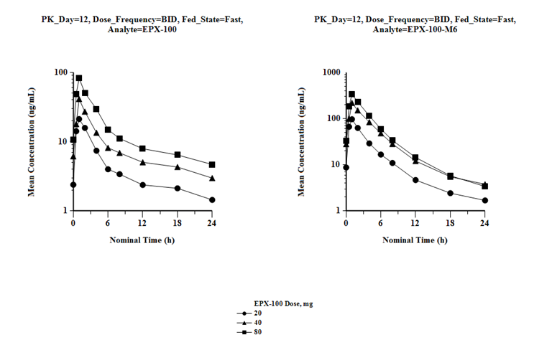
Results – Pharmacokinetics
Dose-dependent pharmacokinetics of 20, 40, and 80 mg EPX-100 after twice daily dosing for 4.5 days – EPX-100 and its primary metabolite, EPX-100-M6

Slide 16
Interpretation of Safety and PK Results
No clinically-significant laboratory abnormalities
No trend for clinical events except drowsiness/ grogginess/somnolence in the highest (80 mg) dose – evidence of crossing BBB
80 mg BID is consistent with previous published literature as safe for healthy adults
PK predictable and concentrations consistent with animal models of efficacy
Interpretation by the SRC as safe and continue to Phase 2

Slide 17
Phase II: Clinical Study Overview
Lisa Zoota, MPH
Global Clinical Project Manager

Slide 18
GreenLight Clinical
GreenLight Clinical works with Epygenix clinical team
Full-service CRO, with offices around the world
Experience across various therapeutic areas (Rare Diseases/Dravet Syndrome, Dermatology, Ophthalmology, Infectious Diseases, etc.)
Key personnel and well-established infrastructure make the study successful
Closely work with the Sponsor by regularly updating status of the study, while the focus is on the care of patients

Slide 19
Phase 2 Study Protocol (EPX-100-001)
A 20 week Multicenter, Randomized, Double-Blind, Placebo-Controlled, Proof of Concept trial of EPX-100 (Clemizole Hyrdochloride) as Adjunctive Therapy in Children with Dravet Syndrome
Phase 2 study to evaluate the efficacy of EPX-100 in divided doses as adjunctive therapy as compared to placebo
24 patients – 18 randomized to EPX-100 and 6 randomized to placebo
Sites locations - 6 US sites
Primary Objective:
Evaluate the efficacy in terms of percent change in seizure frequency (Observational phase vs. the final 4-week period of maintenance phase)

Slide 20
Phase 2 Study Protocol (EPX-100-001)
Secondary Objectives:
Proportion of patients with >50% reduction in mean seizure frequency
Proportion of patient with >25% reduction in mean seizure frequency
Number of convulsive seizure-free days during the 12-week Maintenance Phase
Reduction of episodes of seizures lasting up to 30 minutes or a series of recurrent seizures lasting > 5 minutes
Incidence of rescue anti-epileptic drug (AED) use
Improvement of Clinical Global Impression, Change in QOL in Childhood epilepsy, Change in Targeted Behavior (VAS), Change in the Sleep disturbance Scale & Suicidal Severity Rating Scale

Slide 21
Phase 2 Study Protocol (EPX-100-001)
Key Assessments
Physical and Neurological exam
Medical and Medication History
Vital signs
Blood draws - Safety Laboratory tests and Pharmacokinetic (PK) tests
ECG
Seizure Calendar – to collect seizure frequency
Questionnaires – to assess sleep patterns, assess child’s health and well-being, assess symptom improvement and assess risk factors for suicidality

Slide 22
Phase 2 Study Protocol (EPX-100-001)
To learn how to participate, visit Dravet Syndrome Foundation for details
Additional clinical trial information can be found on ClinicalTrials.gov

Slide 23
Explanation of Phase 2 Studies
Joseph Sullivan, MD
Director UCSF Pediatric Epilepsy Center
Medical Advisor for Epygenix Therapeutics, Inc.

Slide 24
Phase 2 Trial Design (EPX-100-001)
Duration of Study and Study Design
Double Blind Placebo Controlled Phase - 20 weeks
Open Label Extension (OLE) Phase – 52 weeks
Subjects can continue in the Open Label Extension (OLE) for another 52 weeks, optionally
Double Blind
4-Week Titration
12-Week Maintenance
52-Week
Open Label
Extension Study
Screening
4-Week Observation
Titration will be achieved by 1 mg/kg/day increments every 7 days
Patients will remain on the final titrated dose or 160 mg/day for up to 12 weeks
Randomization

Slide 25
Phase 2 Study Protocol (EPX-100-001)
Key Inclusion Criteria:
Male and female, 2-17 years of age
Clinical diagnosis of Dravet syndrome with pathogenic SCN1A mutation
4 or more convulsive seizures per 4-week baseline period (Observational Phase)
Patients should be on a stable regimen of AEDS for > 30 days prior to Visit 1 and generally in good health
Parent or LAR is able to maintain daily seizure calendar for duration of study

Slide 26
Phase 2 Study Protocol (EPX-100-001)
Key Exclusion Criteria:
Known sensitivity, allergy or previous exposure to EPX-100
Exposure to any Investigational drug or device <90 days prior to screening
Seizures secondary to illicit drug or alcohol use, infection, neoplasm, metabolic illness, etc.
Concurrent use of drugs known to interfere with EPX-100
Any medical condition that is considered to be clinically significant and could affect patient safety or study outcome, according to PI’s judgment
Have an active suicidal plan/intent or thoughts in the past 6 months or suicide attempt in the past 3 years

Slide 27
Conclusion and Remark
Alex Yang, JD
Chair of Board
Epygenix Therapeutics, Inc.

Slide 28
Strategic Positioning
A significant opportunity exists for safe and effective treatments for DS
Median Reduction in Frequency of DS Convulsive Seizures
20%
40%
60%
80%
Safety Profile:
Efficacy
Strong
Safety
EPX-100
EPIDIOLEX
(cannabidiol)
39%
Fintepla®
EPX-300
Weak
EPX-200
Fintepla (ZX008)*
(fenfluramine)
Poor
Excellent
42 – 75%
Epidiolex®
EPX-100
Targeting "Fintepla-like" efficacy
Epidiolex® was the first DS drug approved by the FDA in 2018 with moderate safety and efficacy
Fintepla® received FDA approval on June 25, 2020 for DS; labeling includes a boxed warning stating that the drug is associated with valvular heart disease (VHD) and pulmonary arterial hypertension (PAH)
As result of these safety concerns, Fintepla is available only through a restricted drug distribution program, under a risk evaluation and mitigation strategy (REMS)
EPX-100 has shown an excellent safety profile supported by both full IND enabling studies and phase 1 studies and known to be safe in its prior usage
Our scientific evidence along with human proof of efficacy with other compounds, namely EPX-200 and EPX-300, we expect to have highly positive results in phase 2 studies

Slide 29
Epygenix Therapeutics
Questions and Answers

